Slide 1
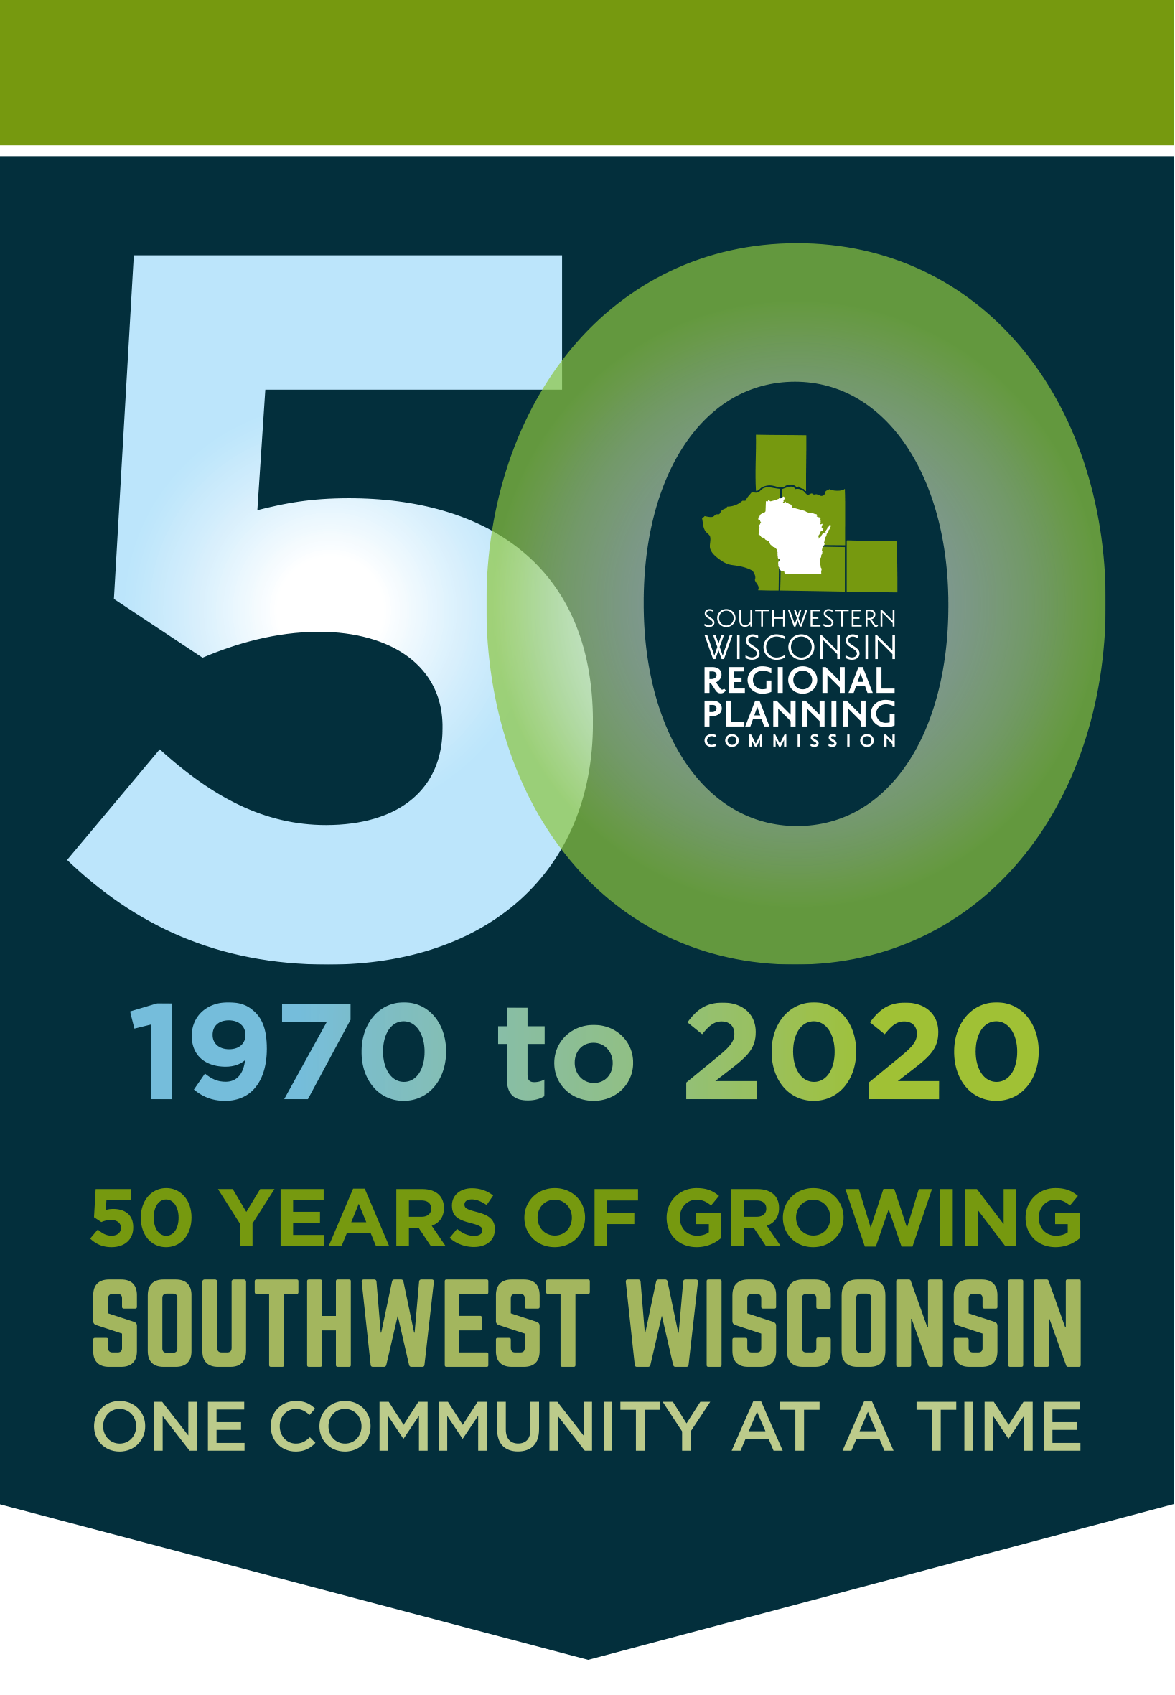
SWWRPC 2020
50 Years!!

Slide 2
Founded:
1970
Grant
Green
Iowa
Lafayette
Richland

Slide 3
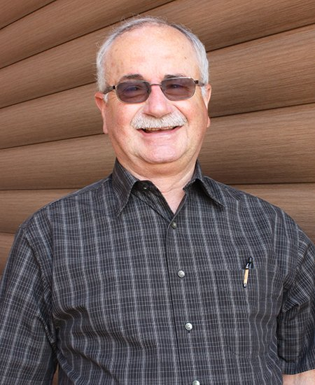
Richland County Commissioners
Marty Brewer

Slide 4
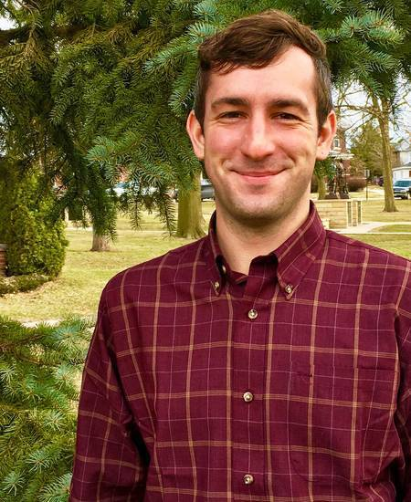
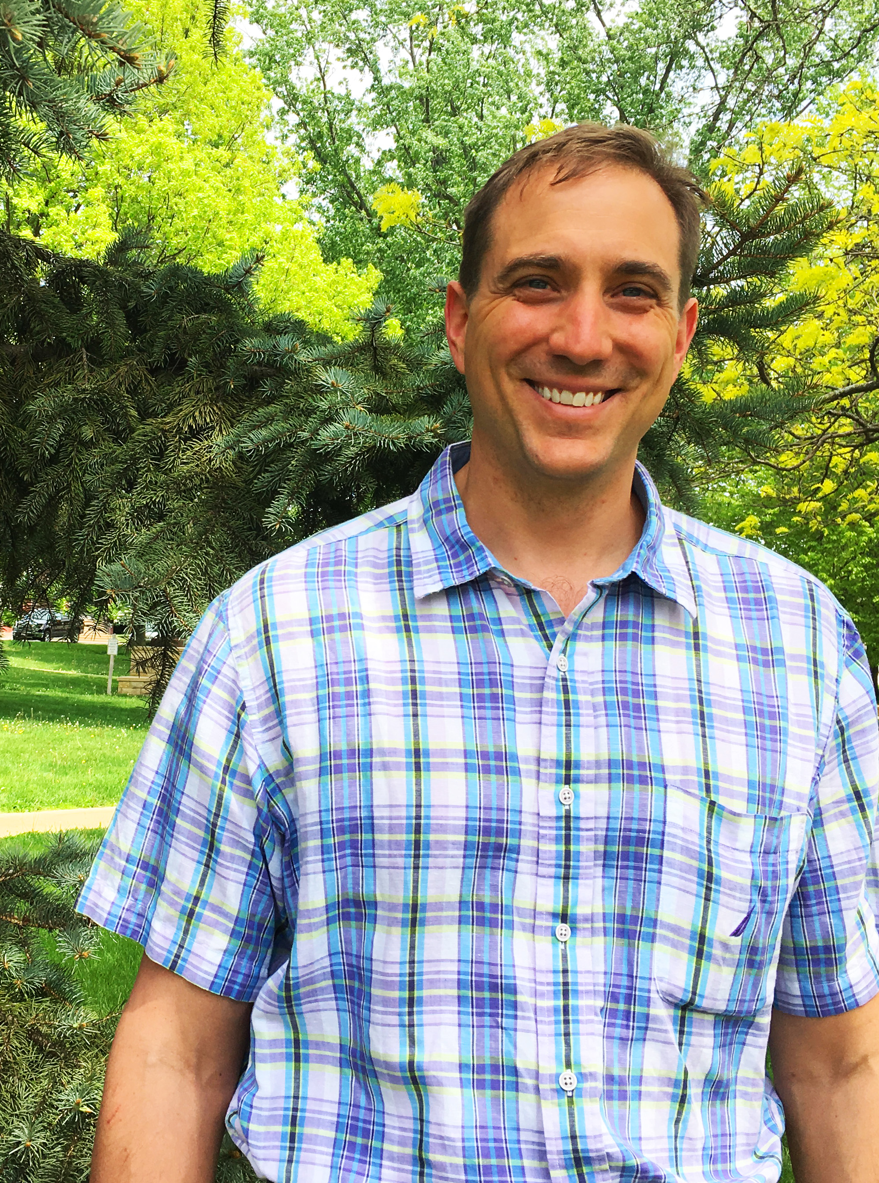
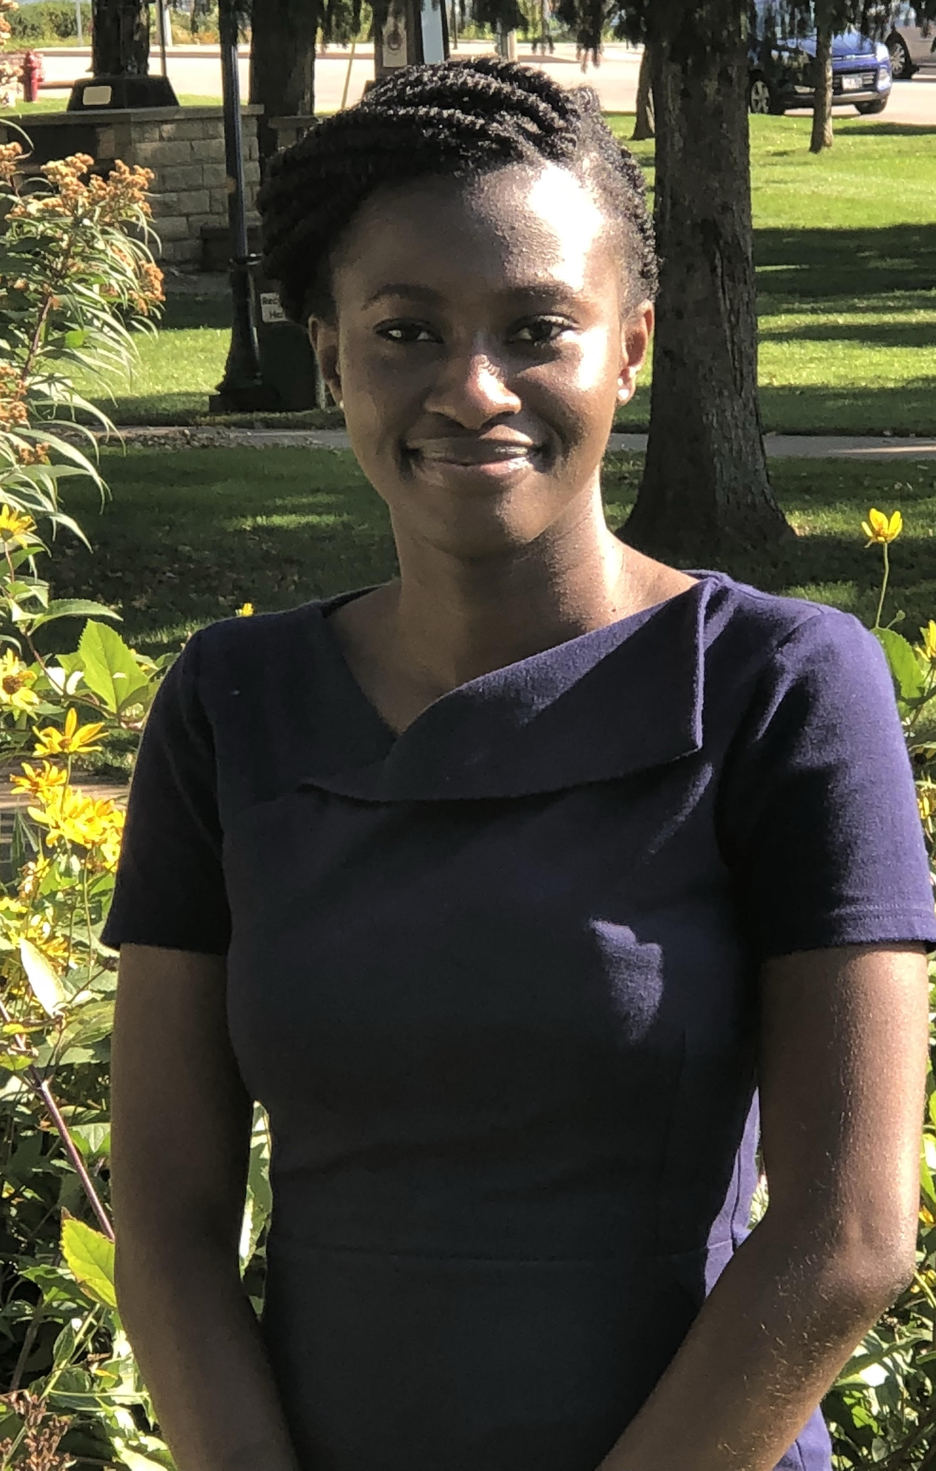
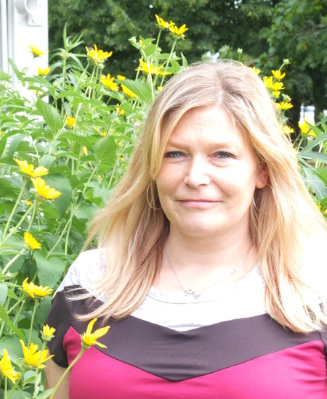
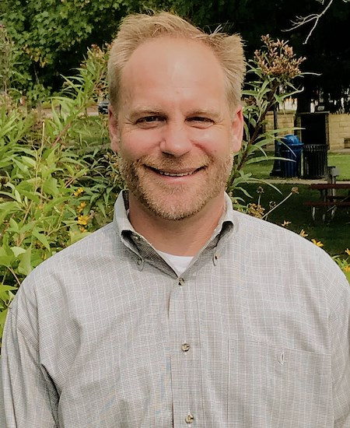
Staff

Slide 5
2020 Annual Budget: $776,553

Slide 6
2020 Annual Budget: $776,553
Richland County Cost: $0.96 per person

Slide 7
2020 Annual Budget: $776,553
Preliminary 2021 budget: $743,450
4.25% reduction
Strategic staffing
Lean overhead
-11% increase in health insurance premiums

Slide 9
How do we serve?

Slide 10
How do we serve?
Funding acquisition

Slide 11
How do we serve?
Funding acquisition
Strategy and data analysis

Slide 12
How do we serve?
Funding acquisition
Strategy and data analysis
Organizational Support & Capacity Building

Slide 13
Funding acquisition

Slide 14
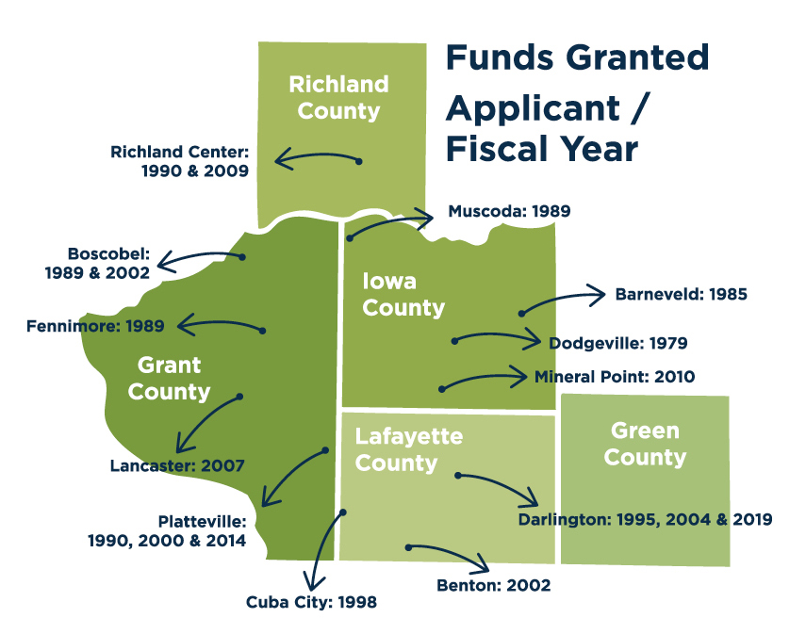
Grant Writing

Slide 15
SWWRPC
Consulting Engineer
Community
Community
Lead applicant
Local match
Business connections

Slide 16
SWWRPC
Consulting Engineer
Community
SWWRPC
Engineer procurement
Grant writing strategy, scoping, eligibility
Economic impacts and project justification
Grant writing

Slide 17
SWWRPC
Consulting Engineer
Community
Consulting engineer
Preliminary design
Opinion of probable costs

Slide 18
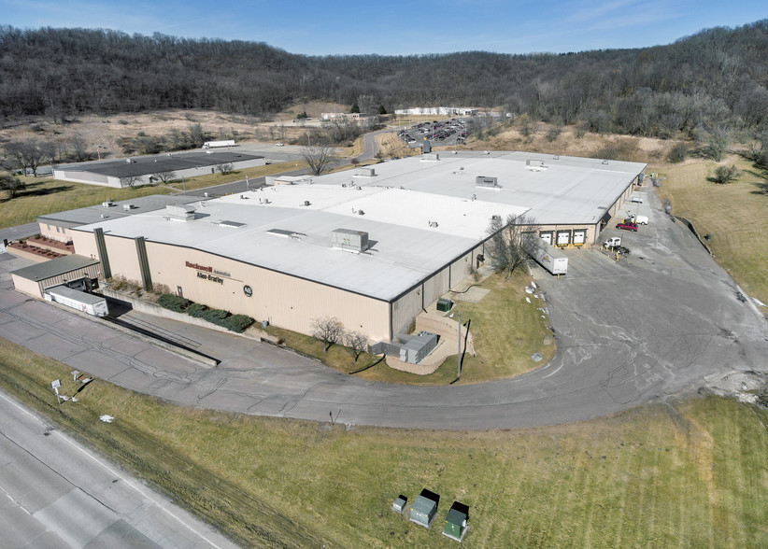
Public Works Grants

Slide 19
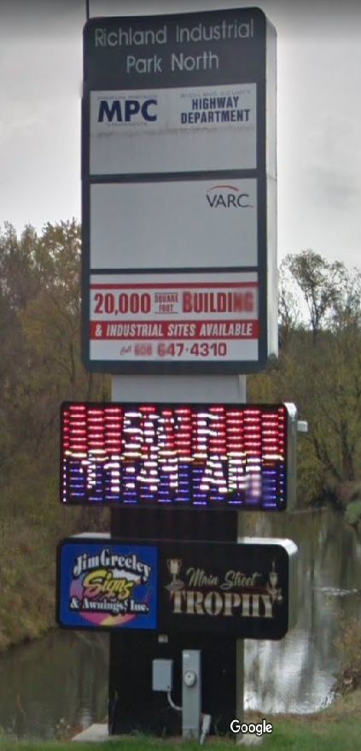
Investment Impacts: 1995-2019
2
Public Works Grants
$1.43 million
Grant Funding
$3.14 million
Total Investment
104
Acres Developed

Slide 20
Economic Impacts
$4.31 million
$101,735
Real estate development
Property Taxes (excluding tax increments)

Slide 21
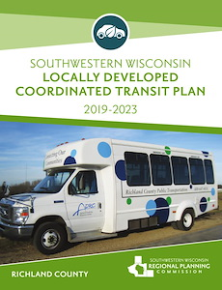
Coordinated Transit Planning
$56,500 in planning funds
$1,837,150 in grants (2020)

Slide 22
Strategy & Data Analysis

Slide 23
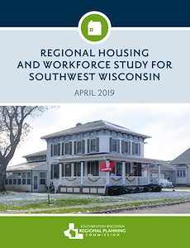
Workforce & Housing Studies
$35,000 from WEDC
$33,000 from County E.D.s
44 community studies

Slide 24
Housing Study Impacts
Driftless Homes Initiative
Up to 60 new units
Estimated $20.7 million investment
Brodhead, Monroe, Argyle, Cuba City, Potosi
“We are making great use of your housing studies…this data has been crucial as we talk to communities about their interest in affordable housing.”

Slide 25
Organizational Support & Capacity Building

Slide 26
GIS and Information Management
Support on-boarding of new professionals
Consistency during turn-over

Slide 27
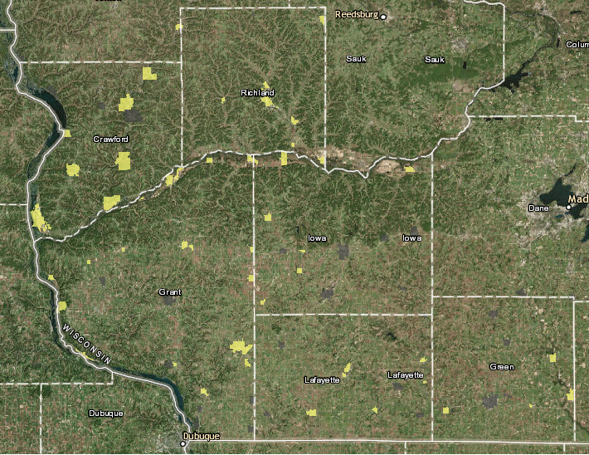
EDA Eligible Municipalities

Slide 28
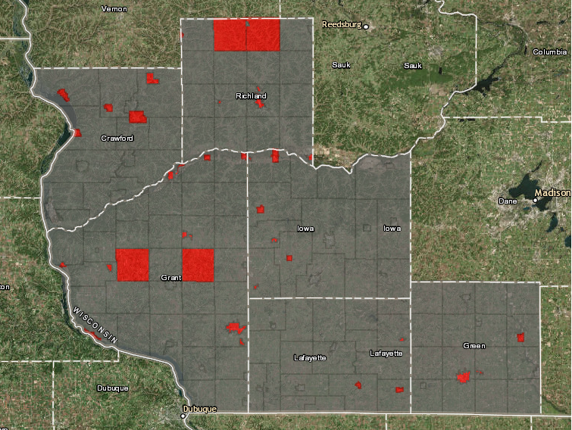
CDBG Eligible Municipalities

Slide 29
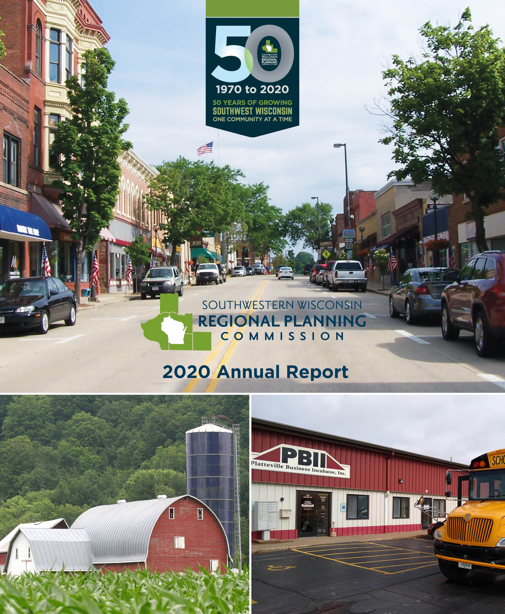
2020 Annual Report
Background info
Recent projects
Historic funding
Budget info

Slide 30
2020-2022 Flood Recovery and Economic Resiliency Grant

Slide 31
Scope of Work
Long-range Community Planning

Slide 32
Scope of Work
Long-range Community Planning
Richland County Strategic Plan

Slide 33
Scope of Work
Long-range Community Planning
Richland County Strategic Plan
Workforce Attraction and Marketing

Slide 34
Scope of Work
Long-range Community Planning
Richland County Strategic Plan
Workforce Attraction and Marketing
Targeted Market Analysis

Slide 35
Scope of Work
Long-range Community Planning
Richland County Strategic Plan
Workforce Attraction and Marketing
Targeted Market Analysis
Non-structural flood mitigation analysis

Slide 36
Project Budget
Total 2-year budget: $411,215
$328,972 from EDA (80%)
$82,243 local match (20%)

Slide 37
Project Budget
Total 2-year budget: $411,215
$328,972 from EDA (80%)
$82,243 local match (20%)
Local Match
$31,078.80 in-kind through Jasen Glasbrenner
$51,164.20 cash match from Richland County and municipalities

Slide 38
Community Planning
Outcome: Roadmap for investment decisions required to achieve the community’s vision
Output: 10-20 year Comprehensive Plan

Slide 42
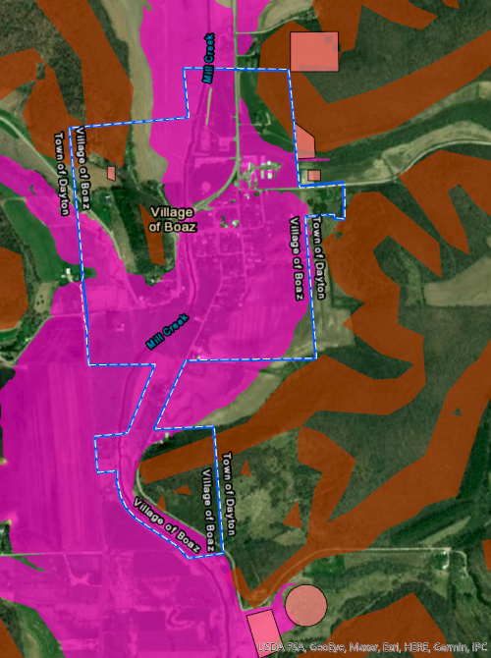

Slide 43
County Strategic Planning
Outcome: A collective vision and goals designed to create a financially and physically resilient county
Output: 3-5 year Strategy to guide annual investment decisions

Slide 44
County Strategic Planning
(Tentative) Timeline: November to April
Process: Four, 2-hour meetings covering:
Vision and purpose
SWOT and PEST Analysis
Goal and Strategy development
Implementation, evaluation, and continuous improvement

Slide 45
Workforce Marketing and Attraction
Locally-driven effort
Create a presence and materials for workforce attraction
Partnership with Chamber and Tourism

Slide 46
Targeted Market Analysis
I.D. business opportunities
Consumption vs. production analysis
Map physical resources

Slide 47
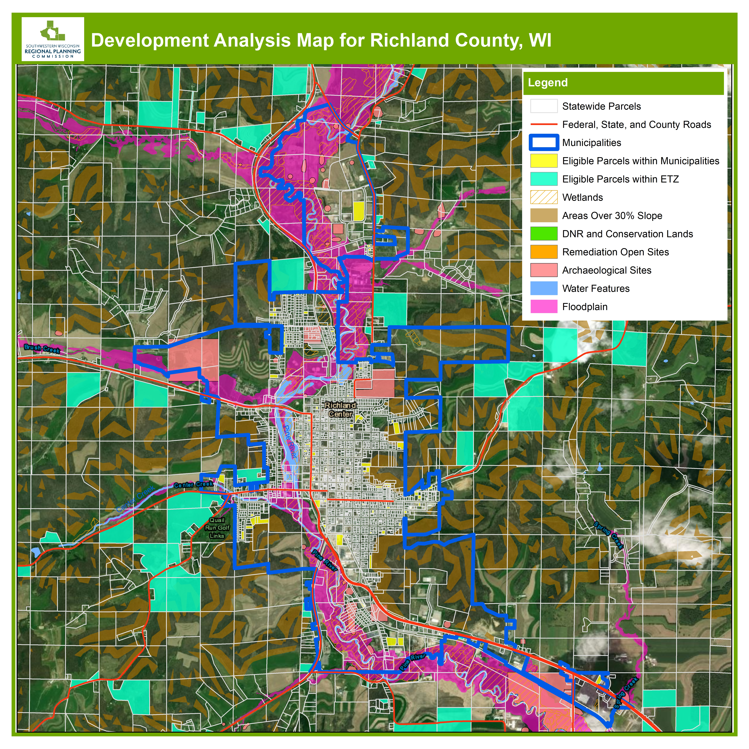
Constructability Analysis

Slide 48
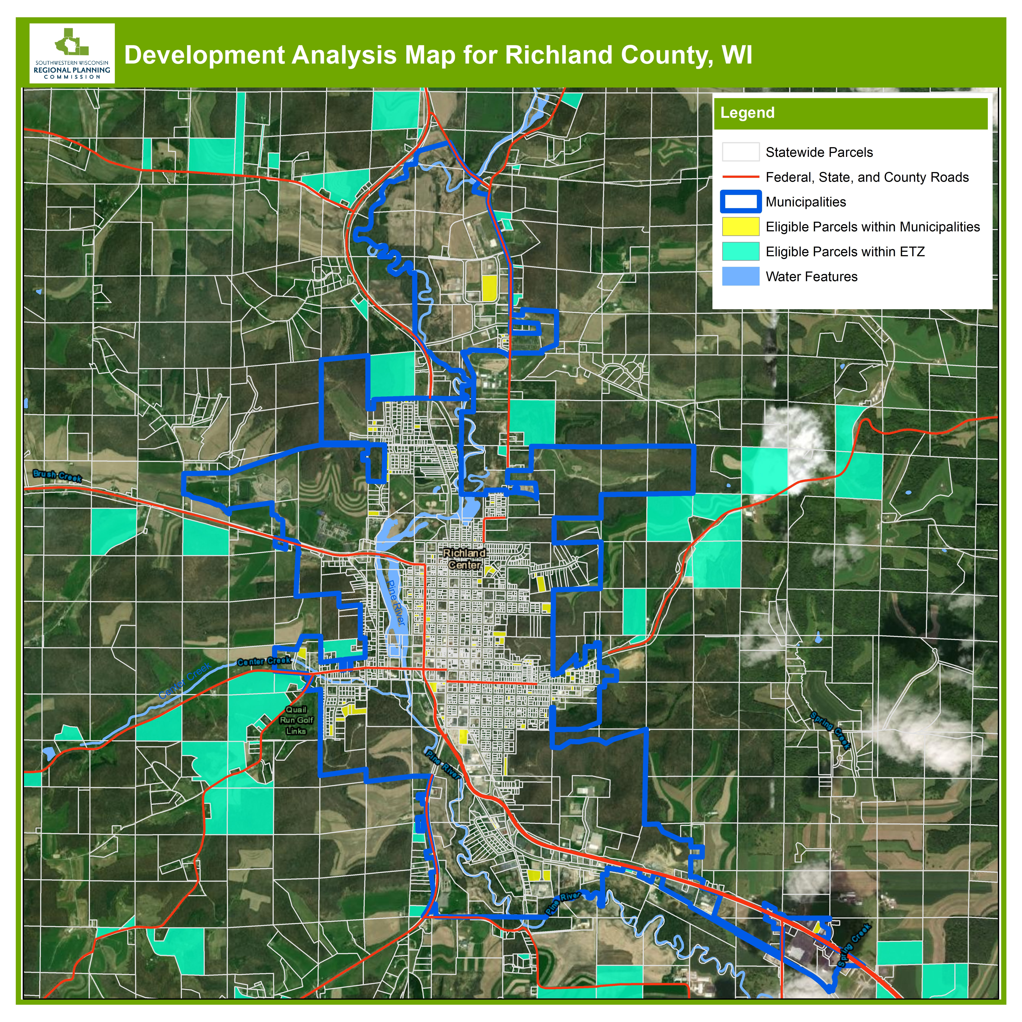
Constructability Analysis

Slide 49
Flood resiliency
Investigate non-structural flood mitigation
Assist with identification of prioritizing critical asset protection

Slide 54
Scope of Work
Long-range Community Planning
Richland County Strategic Plan
Workforce Attraction and Marketing
Targeted Market Analysis
Non-structural flood mitigation analysis

Slide 55
www.swwrpc.org
Thank you!

